Slide 1


Apache Beam
Apache Beam

Slide 2


Hello!
I Am Navdeep Kaur
https://www.linkedin.com/in/navdeep-kaur-aa6b941b/
www.TechnoAvengers.com

Slide 3


















Apache Beam is a unified programming model that can build portable Big Data pipelines.

Slide 4





















Languages
Framework

Slide 5








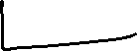



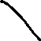
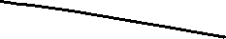
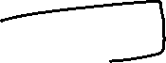




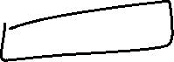
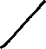






Slide 6







Is Apache Beam Replacement for
Spark, Flink etc?

Slide 7







Which is faster- Apache Beam or Spark?

Slide 8




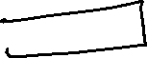
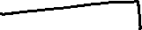
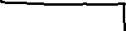



Apache Beam Flow

Slide 9
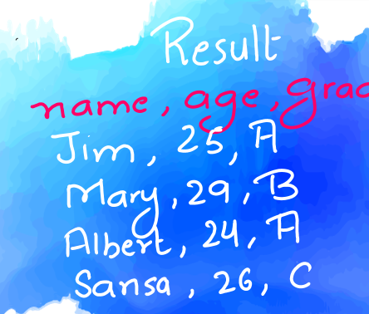
Sample Code: A grade Count
Import apache_beam as beam
p1 = beam.Pipeline()
A_grade_count = (
p1
| beam.io.ReadFromText(‘result.txt’)
| beam.Map(lambda record: record.split(‘,’))
| beam. Filter(lambda record[2]==‘A’)
| beam.Map(lambda record: (record[1],1))
| beam.CombinePerKey(Sum)
| beam.io.WriteToText(‘A_count.txt’)
)
p1.run

Slide 10
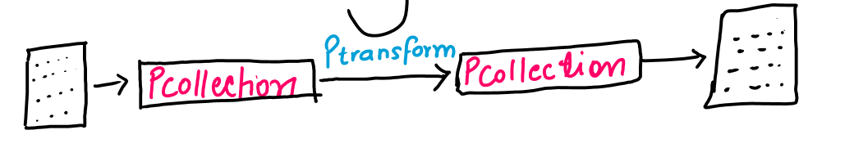
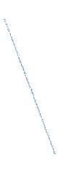


Sample Code: A grade Count
Import apache_beam as beam
p1 = beam.Pipeline()
A_grade_count = (
p1
| beam.io.ReadFromText(‘result.txt’)
| beam.Map(lambda record: record.split(‘,’))
| beam. Filter(lambda record[2]==‘A’)
| beam.Map(lambda record: (record[1],1))
| beam.CombinePerKey(Sum)
| beam.io.WriteToText(‘A_count.txt’)
)
p1.run

Slide 11

PCollections

Slide 12

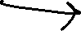


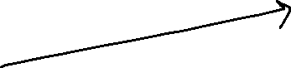




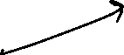

Import apache_beam as beam
p1 = beam.Pipeline()
A_grade_count = (
p1
| beam.io.ReadFromText(‘result.txt’)
| beam.Map(lambda record: record.split(‘,’))
| beam. Filter(lambda record[2]==‘A’)
| beam.Map(lambda record: (record[1],1))
| beam.CombinePerKey(Sum)
| beam.io.WriteToText(‘A_count.txt’)
)
p1.run

Slide 13





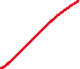







PCollections

Slide 14
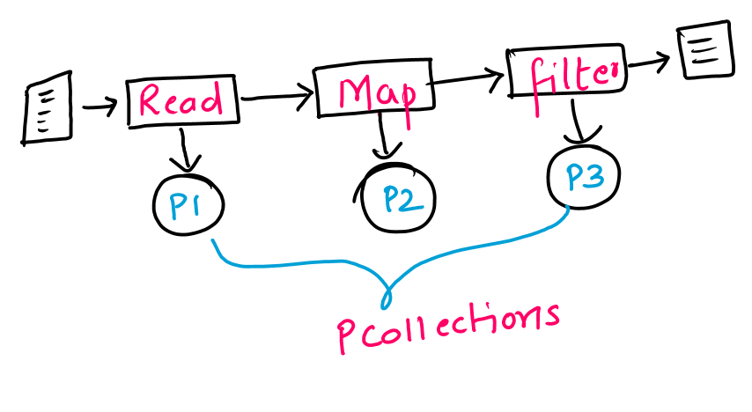

Slide 15



PTransform

Slide 16

Google Colab
Python on Cloud

Slide 17
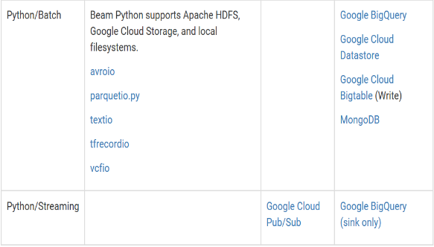
Python Built-in I/O

Slide 18
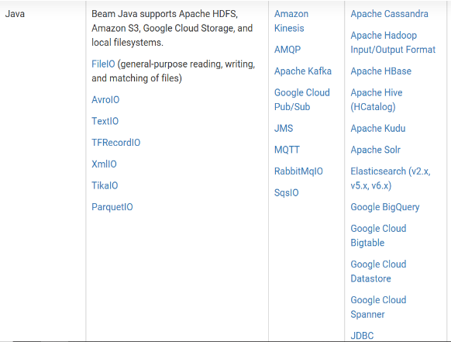
Java Built-in I/O

Slide 19
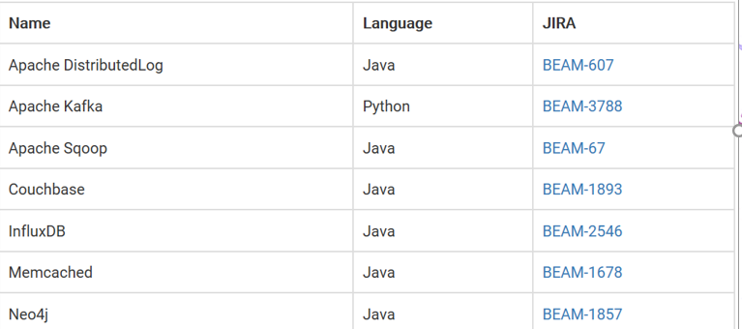
In Progress Built-in I/O

Slide 20

Map
Filter
Transformation
FlatMap
CombinePerKey

Slide 21
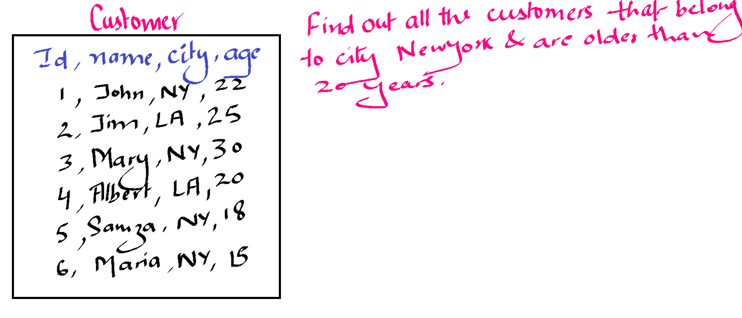

Slide 22
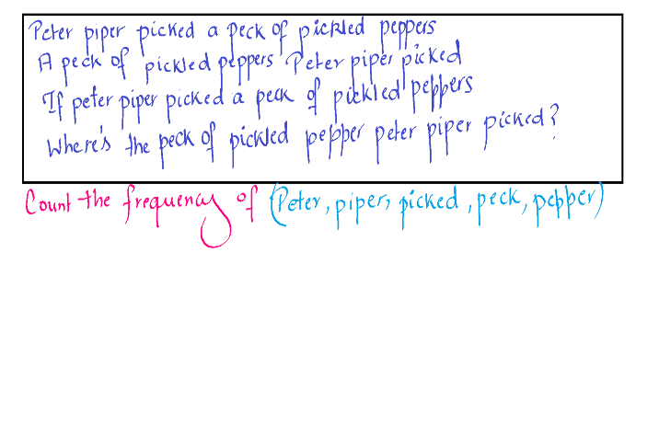

Slide 23
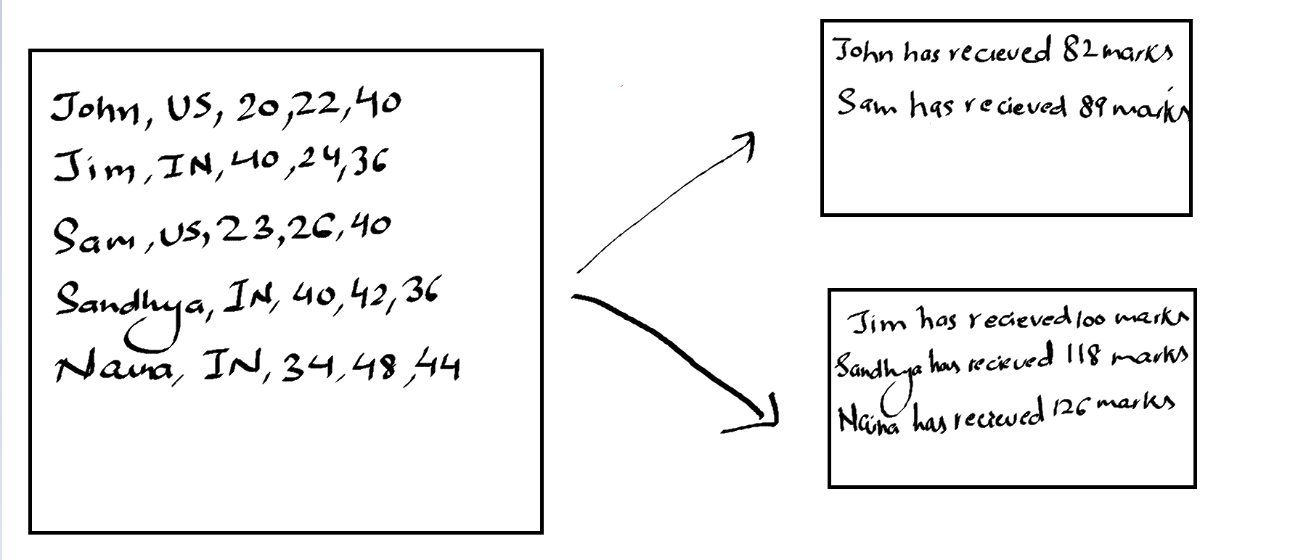




Slide 24
Streaming with
Apache Beam
Apache Beam

Slide 25



Google Pub Sub

Slide 26


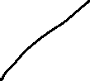






Slide 29
1
3
4
7
3
2
3
5
2:12
2:08
2:04
2:00

Slide 30
1
3
4
7
3
2
3
5
2:12
2:10
2:08
2:06
2:04
2:02
2:00

Slide 31
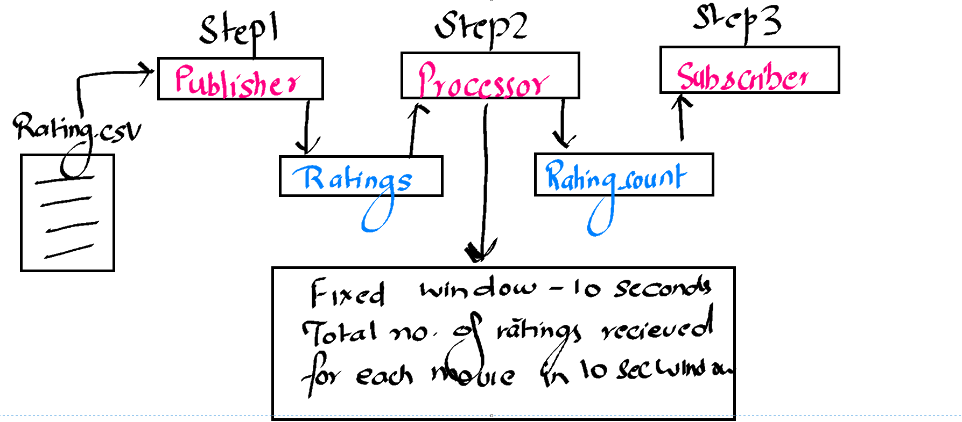

Slide 32

Google Cloud
Dataflow
Apache Beam

Slide 33

What is Google Cloud Dataflow?
Google cloud dataflow is a Managed Service
For running Data processing pipeline
It uses Apache Beam underneath
It can be used for batch & streaming pipelines

Slide 34




Pcollection
Pcollection
Pcollection
Data Source
Deploy
Data Sink
Workers
Compute Engine

Slide 35



How to use Dataflow?

Slide 36
Side Inputs
Extra Input for Pardo DoFn Object

Slide 37
Additional Outputs in Pardo transformation
Side Outputs
Output1 – Customers that live in Newyork city
Output2 – Customers that live other cities
Output3 – Customers whose name starts with J

Slide 38
Window2
Window1
8
10:06
10:07
10:04
10:02
2
7
3
5
10:03
10
10:15
10:10
10:05
By Default, late elements are dropped

Slide 39
Window2
Window1
18
8
10:06
10:07
10:04
10:02
2
7
3
5
10:03
10
10:00
10:05
10:10
10:15
When allowed lateness is set in windows

Slide 40
Triggers
Apache Beam

Slide 41
Triggers
Instruct Beam when to emit window results
Default trigger is attached to every window
We can change triggers
Early firing – Estimated results
Late firing – Accommodate late elements

Slide 42
Type of Triggers
Event-Time Trigger
Processing-Time Trigger
Data-Driven Trigger

Slide 43
Composite Triggers
Repeatedly
AfterEach
AfterFirst
AfterAll
Finally

Slide 44
Composite Triggers
'Window' >> beam.WindowInto(window.FixedWindows(10),
trigger=Repeatedly(
AfterAny(
AfterProcessingTime(20),
AfterCount(10)
),
accumulation_mode=AccumulationMode.DISCARDNG)

Slide 45
Composition with Default Trigger
'Window' >> beam.WindowInto(window.FixedWindows(60),
trigger=AfterWatermark(
early=AfterProcessingTime(10),late=AfterCount(2)),
accumulation_mode=AccumulationMode.DISCARDNG)
Window will emit result whenever last element of window is arrived
Window will emit early results 10 seconds after windows starts
Window will emit results whenever 2 late elements are received after window end

Slide 46
Composition with Default Trigger
'Window' >> beam.WindowInto(window.FixedWindows(60),
trigger=AfterWatermark(
early=AfterProcessingTime(10)),
Allowed_lateness = 24*60*60,
accumulation_mode=AccumulationMode.DISCARDNG)
Window will emit result whenever last element of window is arrived
Window will emit early results 10 seconds after windows starts
Window will emit results whenever late elements are received till 1 day

Slide 47
Composite Triggers
'Window' >> beam.WindowInto(window.FixedWindows(10),
trigger=AfterEach(
AfterProcessingTime(20),
AfterCount(10),
AfterProcessingTime(10),
),
accumulation_mode=AccumulationMode.DISCARDNG)

Slide 48
Beam SQL
Apache Beam

Slide 49
Beam SQL
Apply SQL to transform PCollections
PCollections data should be in Row format
Row is defined with schema

Slide 50
Beam SQL Example
Step1:
Schema appSchema =
Schema
.builder()
.addInt32Field("appId")
.addStringField("description")
.build();
Step2:
Row row =
Row
.withSchema(appSchema)
.addValues(1, "Some cool app")
.build();
Step3:
PCollection<Row> testApps =
PBegin
.in(p)
.apply(Create
.of(row)
.withCoder(RowCoder.of(appSchema)));
Step4:
PCollection<Row> filteredNames = testApps.apply(
SqlTransform.query("SELECT appId, description FROM PCOLLECTION "
+ "WHERE id=1"));

Slide 51
Thanks!
Any questions?
You can find me at:
https://www.linkedin.com/in/navdeep-kaur-aa6b941b/
navdeep220161@gmail.com

